Slide 1
Predicting the Credit Status
April 5th
Lu Zheng
Yuxin Yao
Zhiquan Cui

Slide 2
Research Context
Why do we do this research?
1. Credit Satus predicts ability to repay based on various factors.
2. Lenders use predictive models to minimize default rist.
3. Credit scores are crucial, along with other indicators such as income and employment history.
4. Predicting credit status is complex and requires assessing risk and benefits.

Slide 3
Agenda
01
EDA
02
Model Selection
03
Model Validation
04
Conclusion
Quantitative Variables
Qualitative Variables
Main Effect Model
Interaction Model
Final Model
ROC & AUC
Hosmer-Lemeshow Test
Predictive Power
Residual Diagnostics
Impact
Limitation
Future Improvements

Slide 4
01
EDA
Quantitative Variables & Qualitative Variables
Notes:
Before building our model, let’s perform an EDA to see how the variables look like!

Slide 5
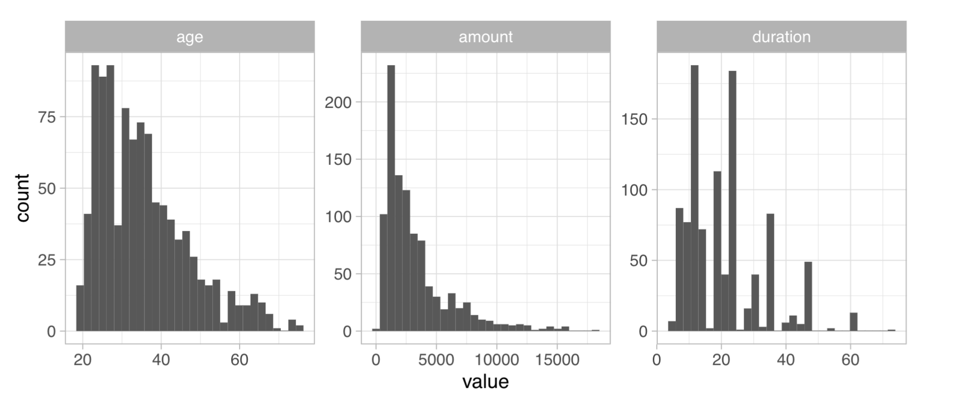
Quantitative Variables
Notes:
First, let’s look at the quantitative variables. As we can see, they are all right skewed with long right tail.

Slide 6
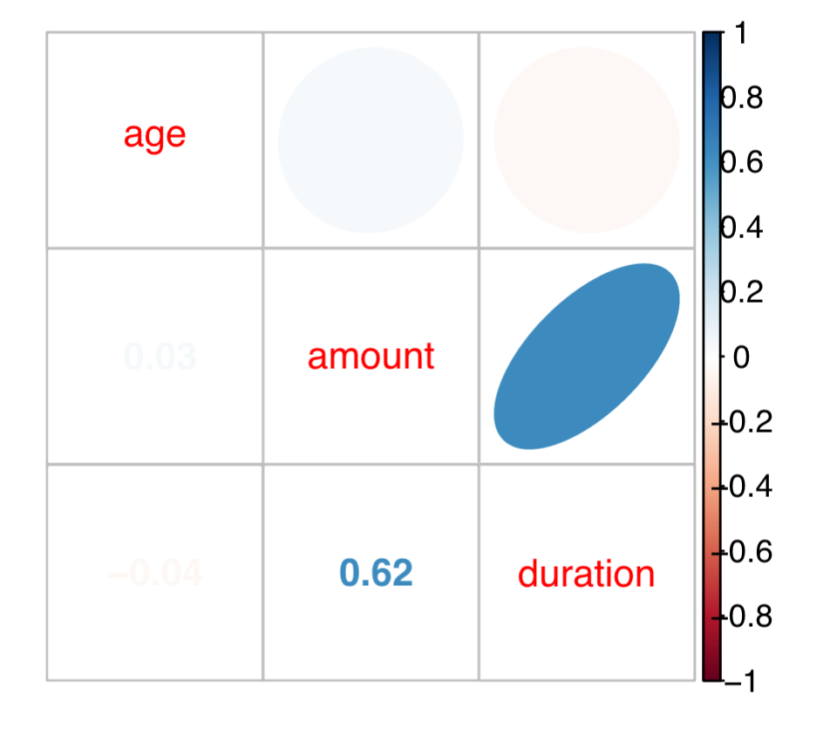
Quantitative Variables
Notes:
Now let’s perform multivariate data analysis. We can see that amount and duration are highly correlated. To avoid multicollinearity, we need to drop one of them.

Slide 7
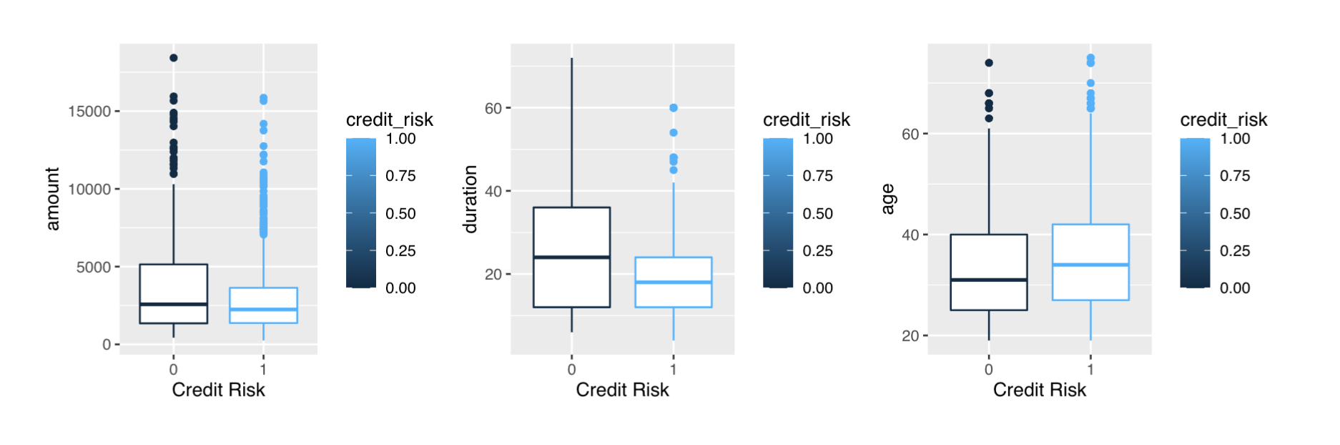
Quantitative Variables
Notes:
Let’s look at this side by side box plots, we can see there is kind of significant difference between duration and age for two credit groups, but not for amount. So we decide to drop amount. Also, we will trim the observations aged over 60 as there is only few of them.

Slide 8
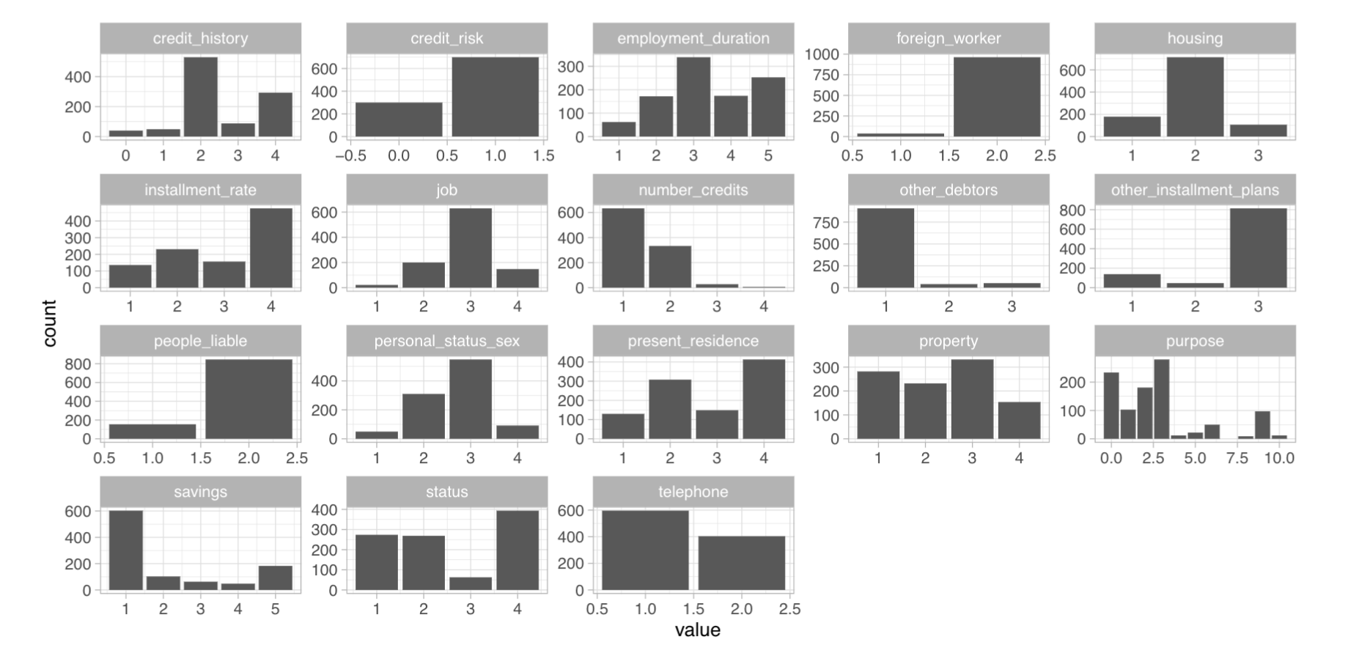
Qualitative Variables
Notes:
Now, let’s look at the box plots for qualitative variables. Since there are only two levels for our response variable, so we may consider fitting a multiple logistic regression model.

Slide 9
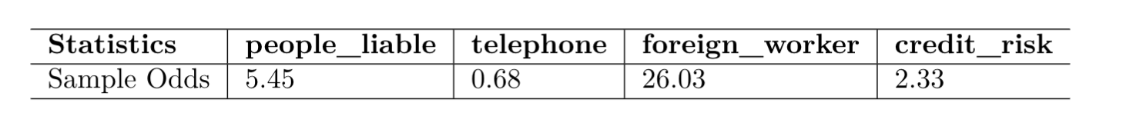
Qualitative Variables
Notes:
Here are the sample odds of our binary variables. The statistics for credit_risk is 2.33 which indicates that we should have a cutoff probability of around 70% in the model validation.

Slide 10
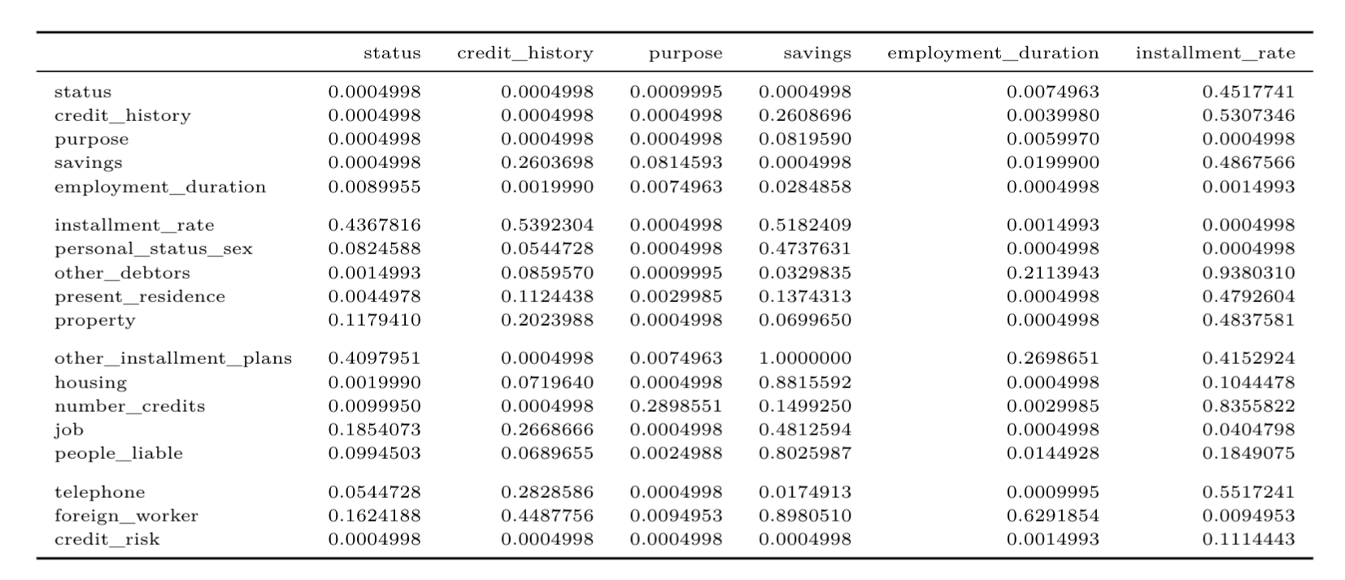
Qualitative Variables
Notes:
Lastly, we grouped all the categorical data to perform Pearson Chi-square test and get all the p-values. Variables in red box are highly correlated with most of the other predictors and those in yellow box have weak association with credit risk. Therefore, we will include only status, savings, property and other_installment_plans in our model.

Slide 11
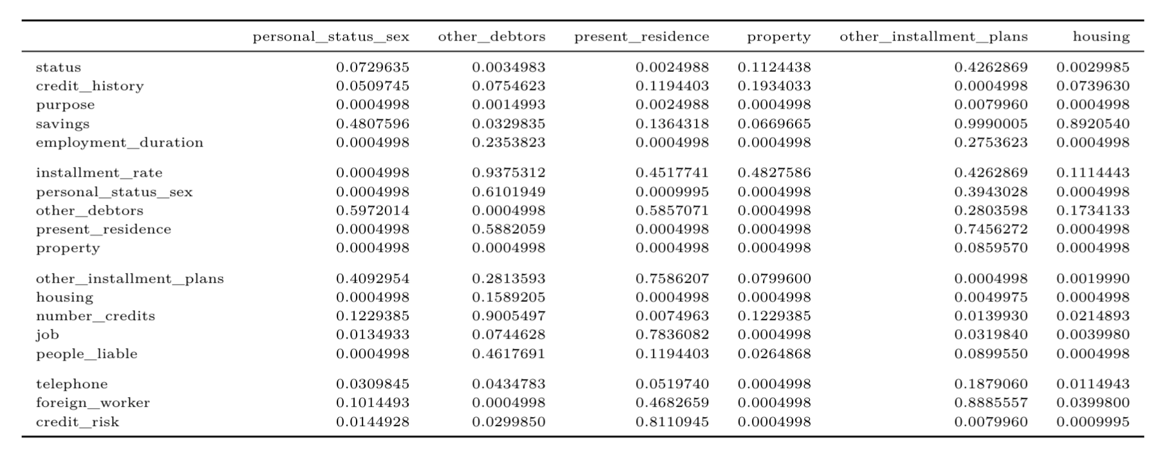
Qualitative Variables

Slide 12
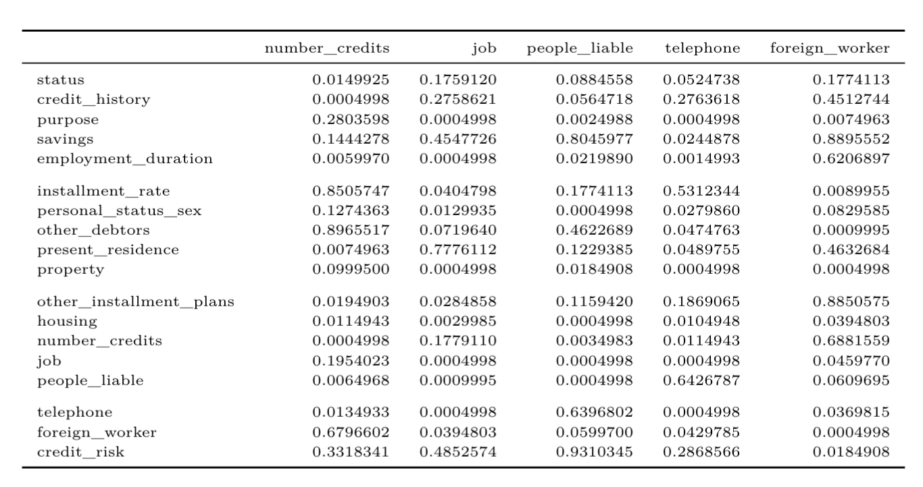
Qualitative Variables

Slide 13
02
Model Selection
Main Effect Model, Interaction Model, Final Model
Notes:
Here we move to the Model Selection. In this section, we mainly divided it into two parts: Main Effect Model & Interaction Model, And trying to find the Final Model by comparing

Slide 14
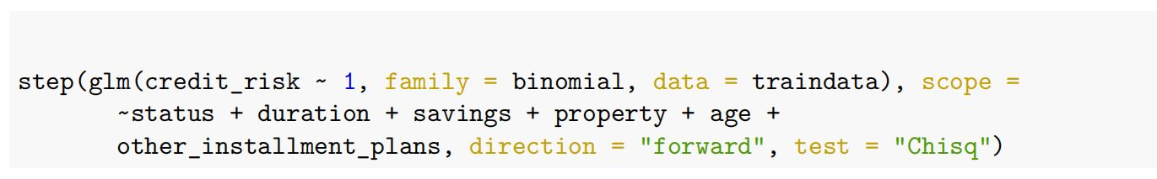
Main Effect Model
Without considering interaction terms, Implement forward Selection based on AIC
Notes:
and try to find the most convincing Main Effect Model

Slide 15
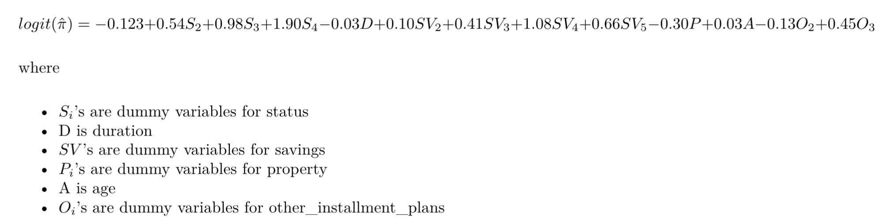
The most convincing Main Effect Model
(from forward method)
AIC: 761.57
Notes:
Finally, we got……, and the AIC of the model is 761.57

Slide 16
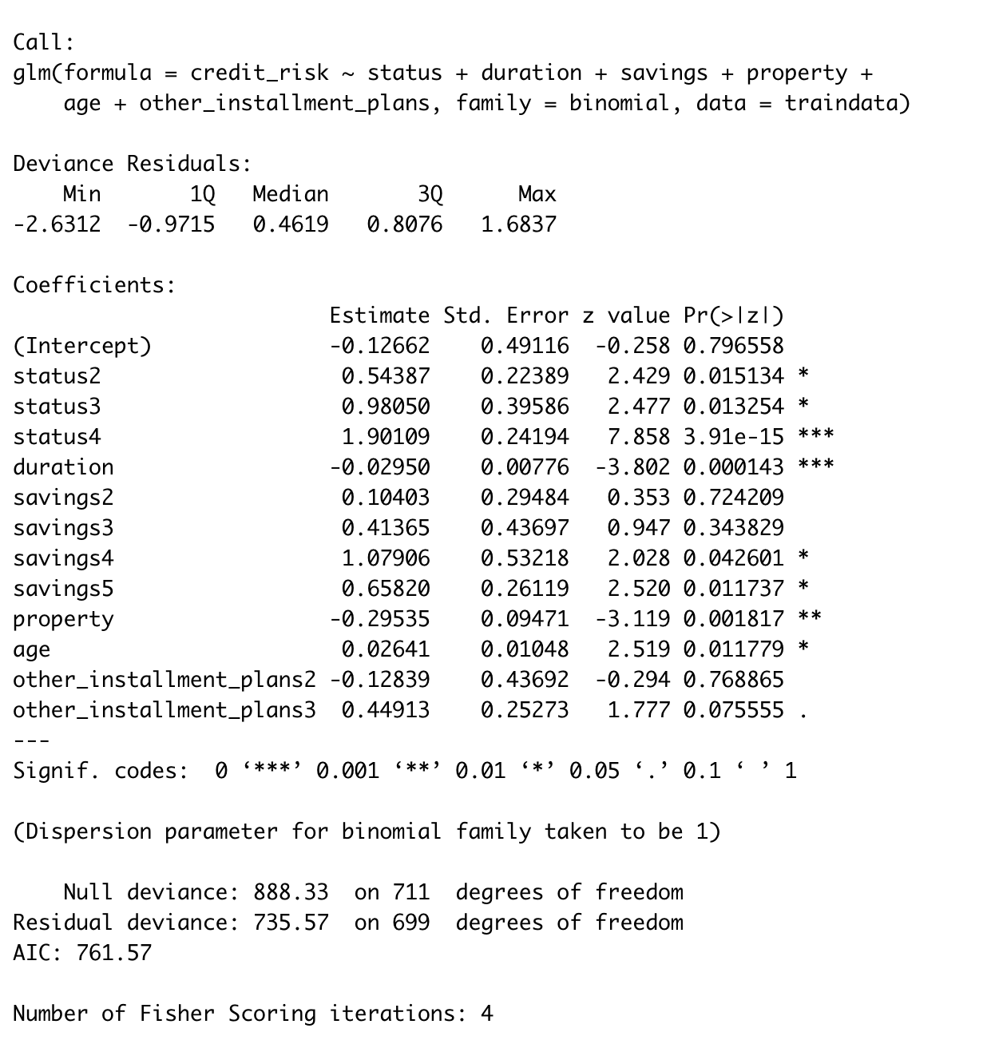
Notes:
But when we look closely at this model, we’ll find that few predictors’ p-value are extremely large. which means they are insignificant

Slide 17
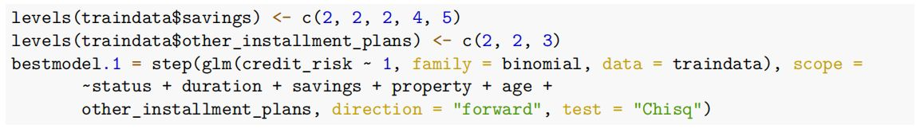
Optimizing model mannually
Notes:
Therefore, we tried to optimize the model mannually

Slide 18
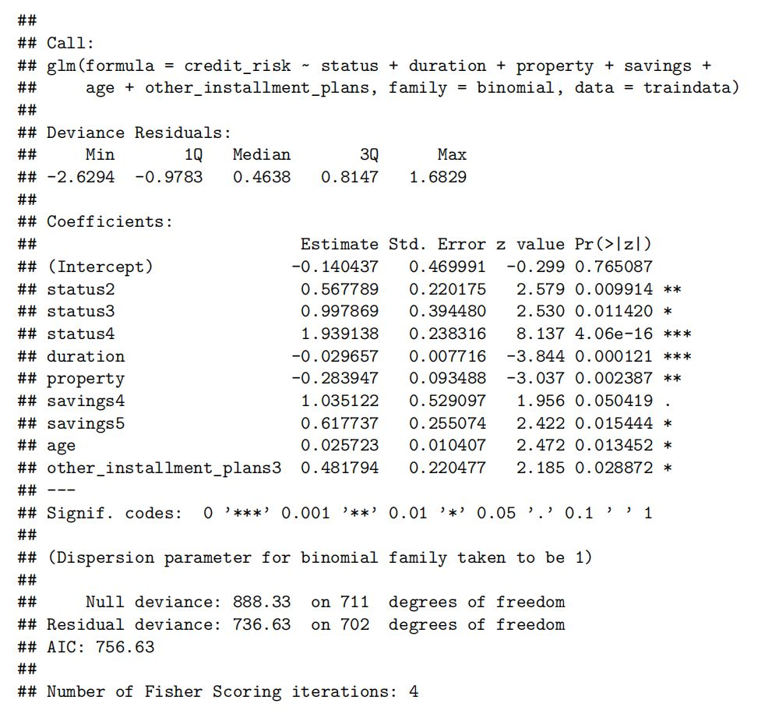
Notes:
And get a new model. In this model, all the predictors are significant and the AIC is smaller.

Slide 19
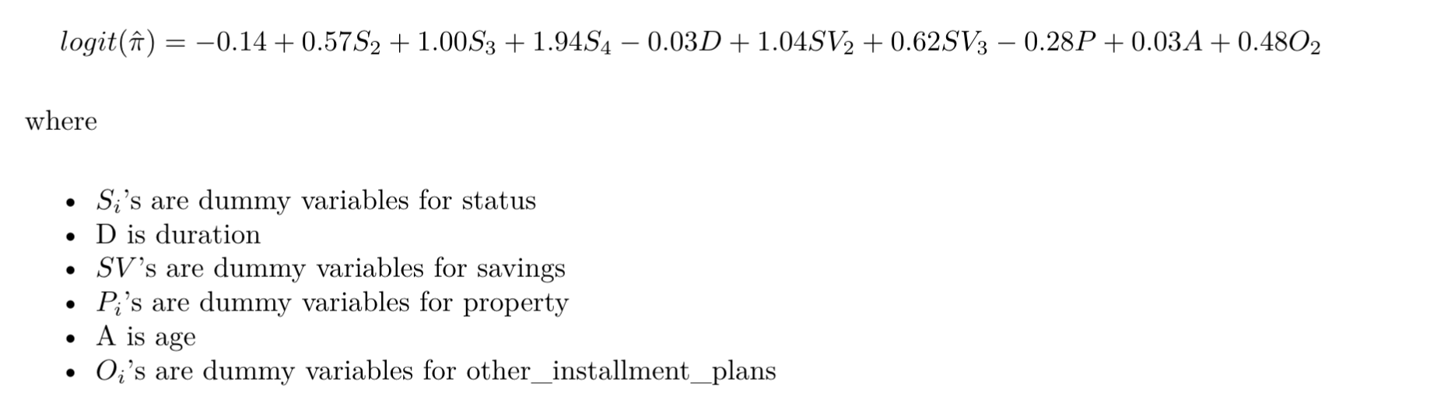
The best Main Effect Model
AIC: 756.63
Notes:
So, we conclude the the new model is our best Main Effect Model.

Slide 20
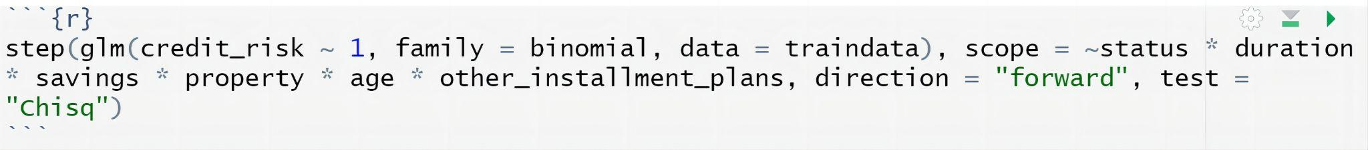
Interaction Model
Taking interaction terms into account, Implement forward Selection based on AIC
Notes:
Next, In the interaction Model part. We……

Slide 21
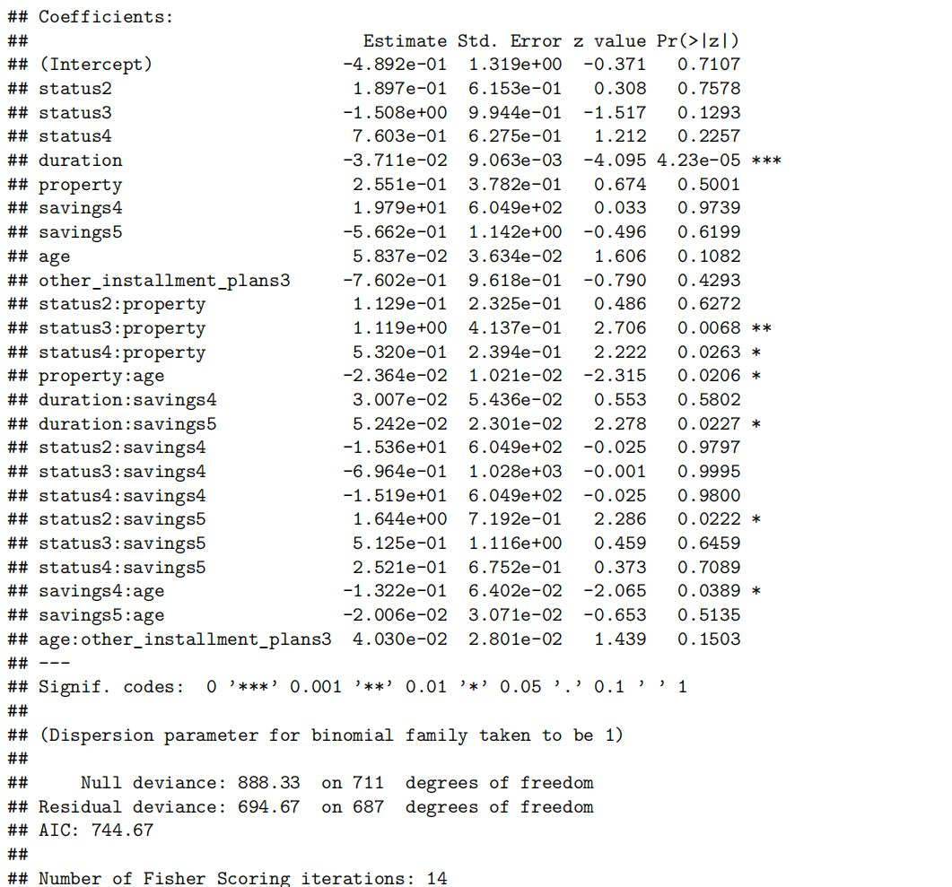
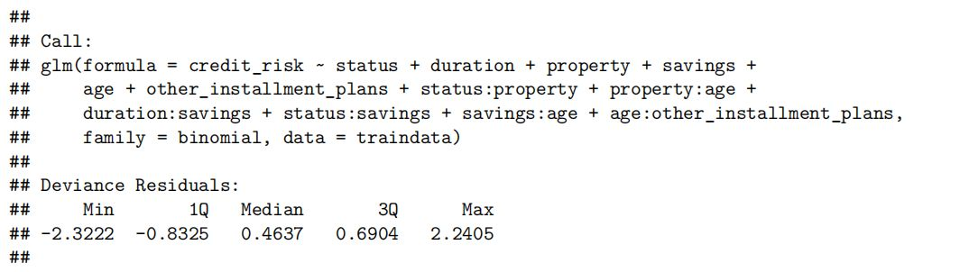
The most convincing Interaction Model
(from forward method)
Most of p-values are extremely large
the selected model doesn’t give significant predictors
Notes:
By the forward method, we found ……
But most of p-value in this model are extremely large, which means

Slide 22
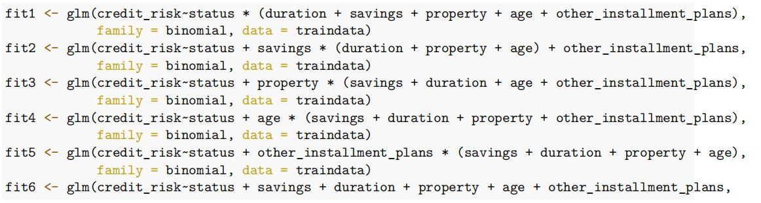
try to add interaction terms mannually
Notes:
To solve this, We…… by the following code

Slide 23
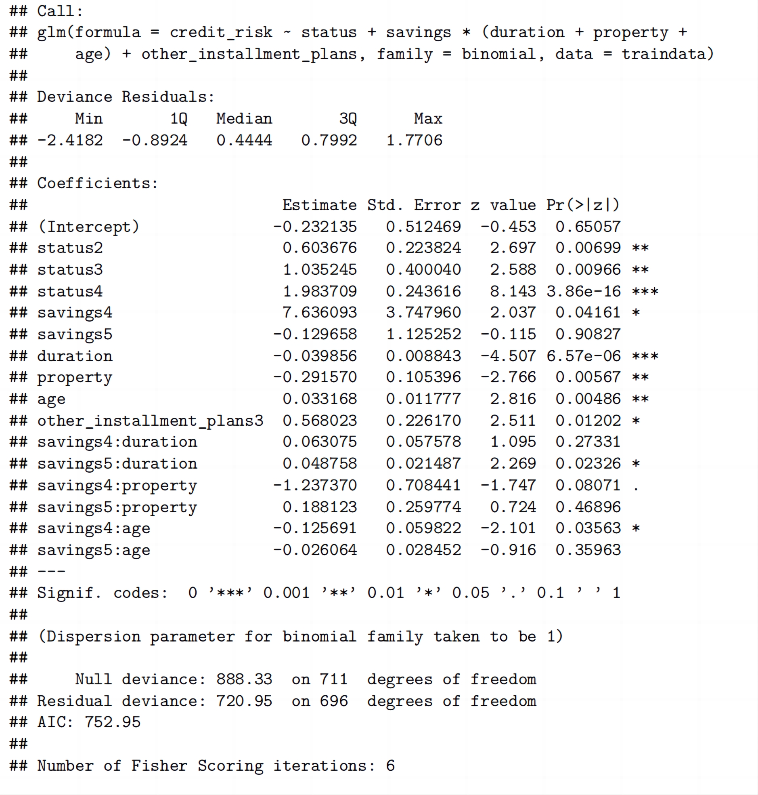
Notes:
And we get a new model with significant predictors.

Slide 24
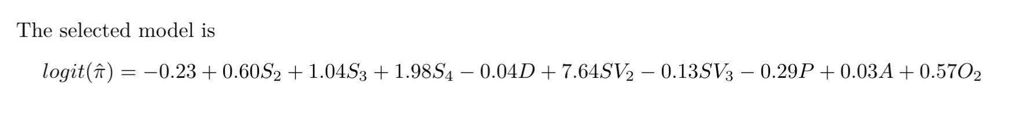
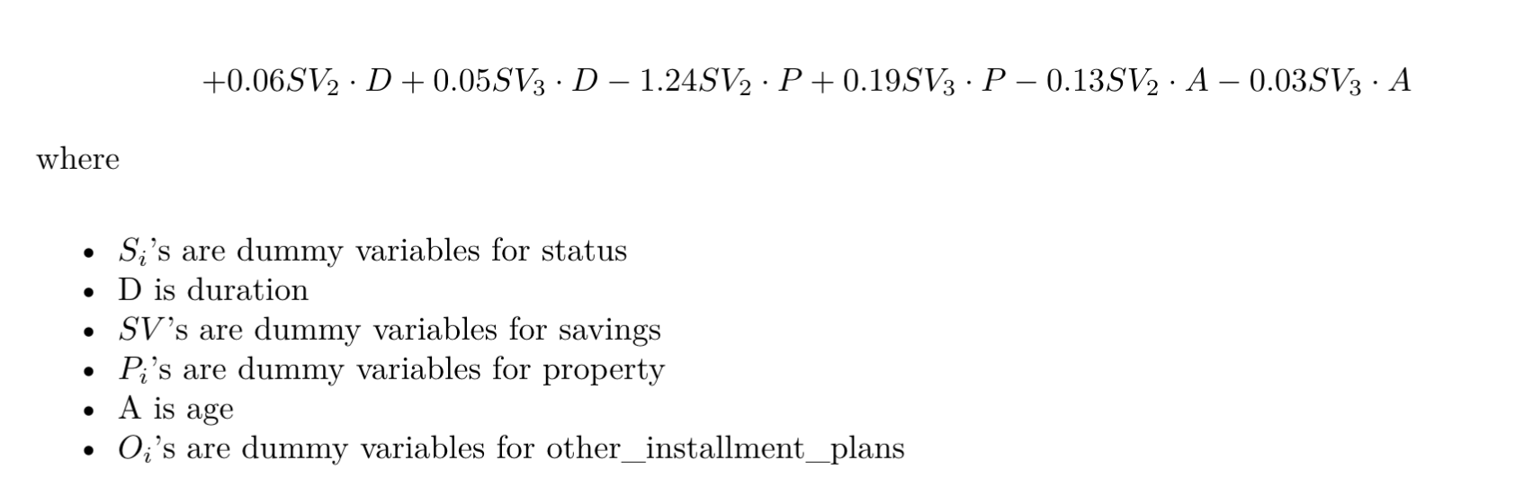
The best Interaction Model
AIC: 752.95
Notes:
Therefore, we conclude that the new model is our best Interaction Model.

Slide 25
compare the Best Main Effect Model & Interaction Model
AIC of the Best Interction Model is smaller
can best describe our data!

Slide 26
03
Model Validation & Diagnostics
ROC, AUC, Hosmer-Lemeshow Test, Residual Diagnostics
Notes:
Now we come to the model validation and residual diagnostics.

Slide 27
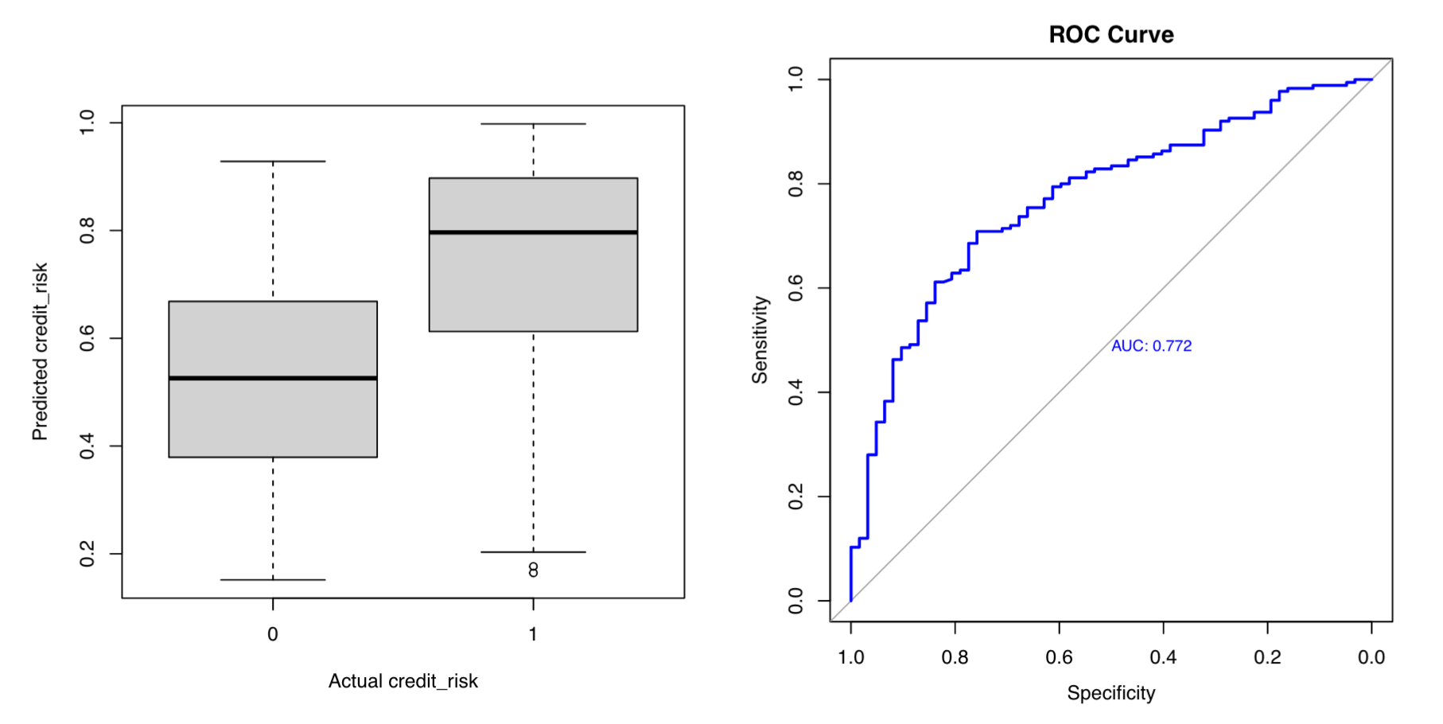
ROC & AUC
Notes:
First, we will look at the ROC curve and the area under curve. As we can see, the ROC curve is well above the diagonal and the area under curve is 0.772 which is fairly large. Also, if you look at the graph on the lefthand side, you may see that our model gives a lower predicted probability to a bad credit person and a higher probability to a good credit person.

Slide 28
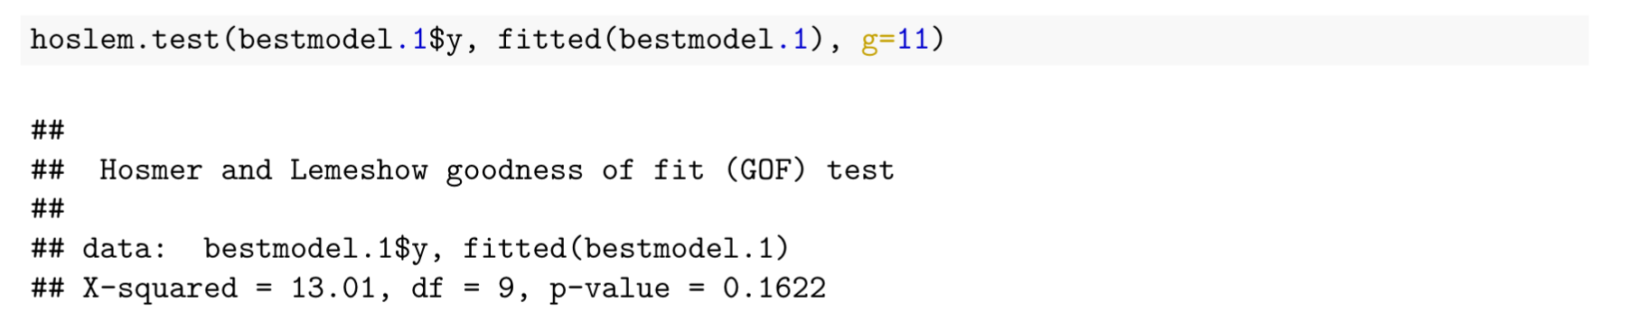
Hosmer-Lemeshow Test
Notes:
And then we performed the Hosmer-Lemeshow Test. The p-value is high which indicates our model fits the data well.

Slide 29
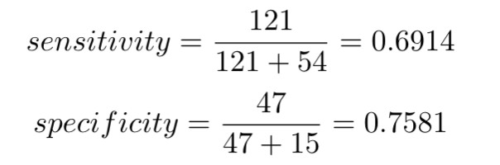
Classification Table & Predictive Power
 | Predicted Value
Actual Value |  | 0 | 1
 | 0 | 47 | 15
 | 1 | 54 | 121
Notes:
Now let’s look at the classification table. Our model is has a sensitivity of 0.69 and specificity of 0.76.

Slide 30
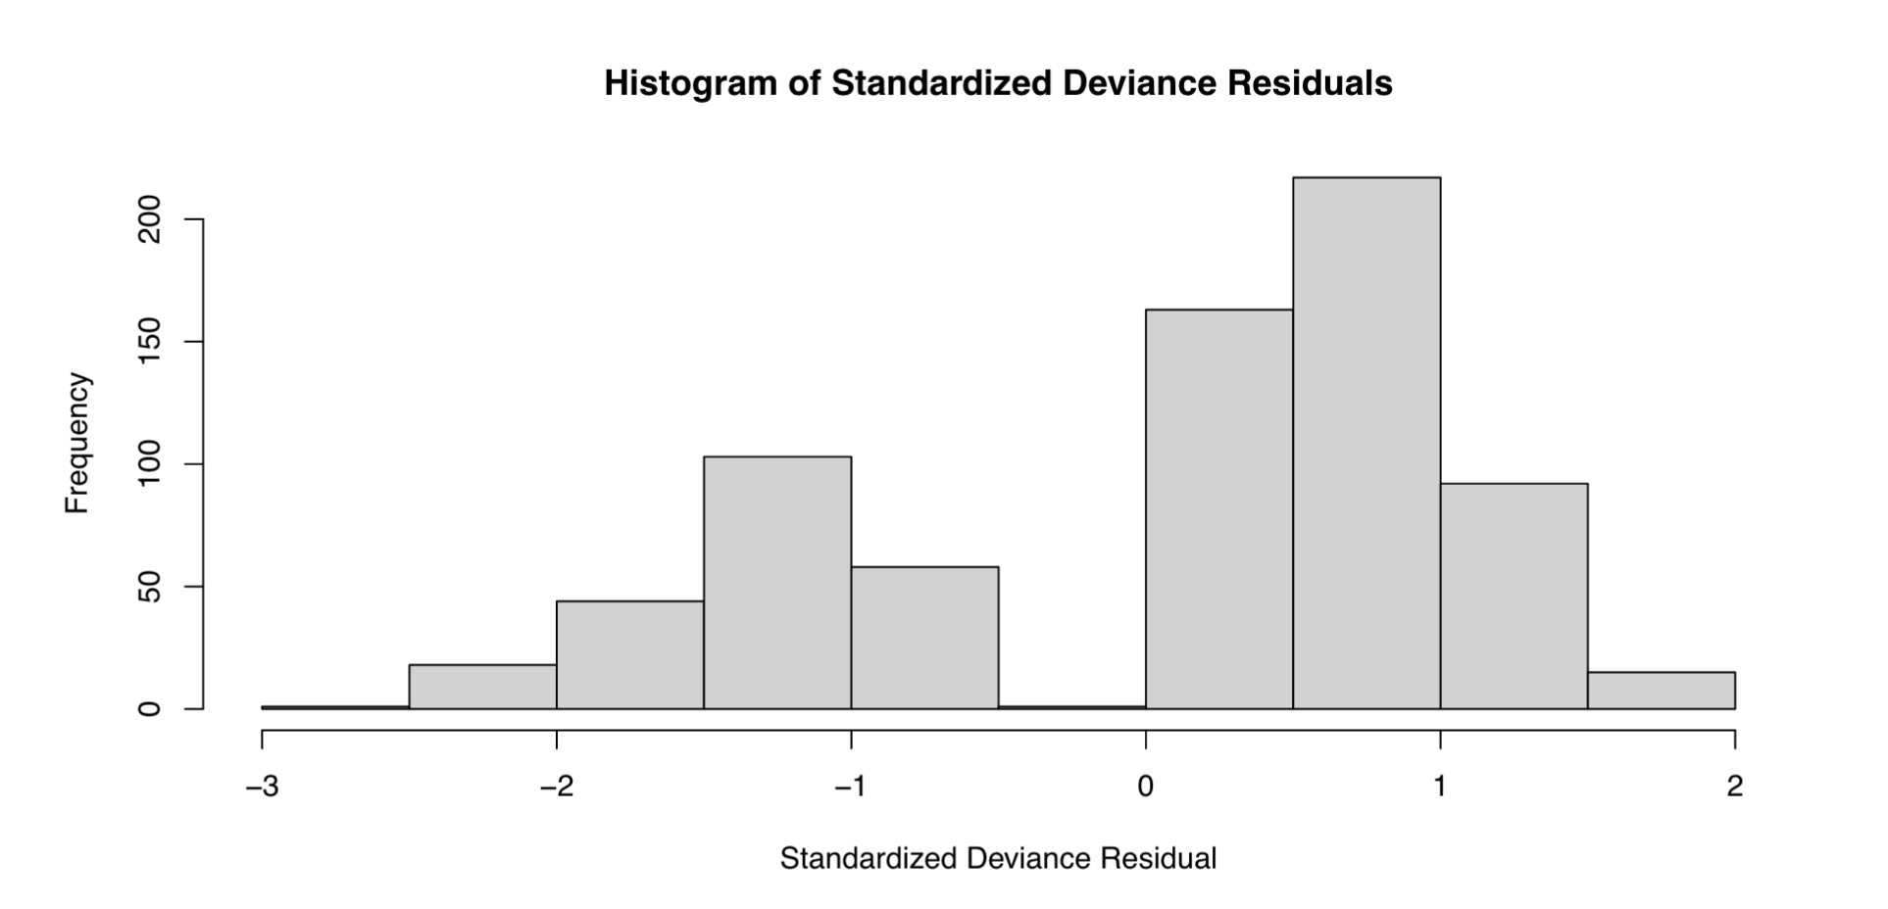
Residual Diagnostics
Notes:
Last but not least, we will move to the residual diagnostics. As you can see from this histogram, it is kind of normal and the mean of the residuals is near to 0.

Slide 31
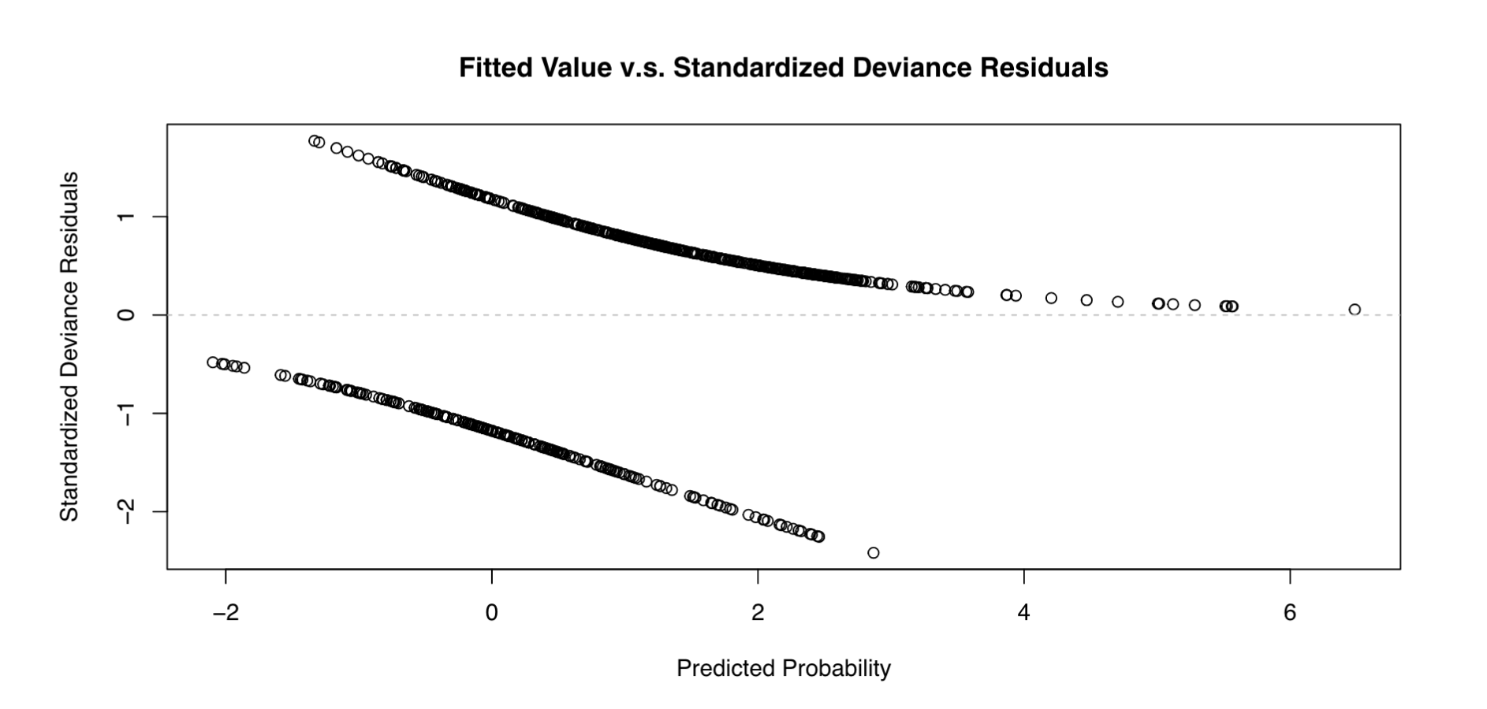
Residual Diagnostics
Notes:
This is a residual plot of our model.

Slide 32
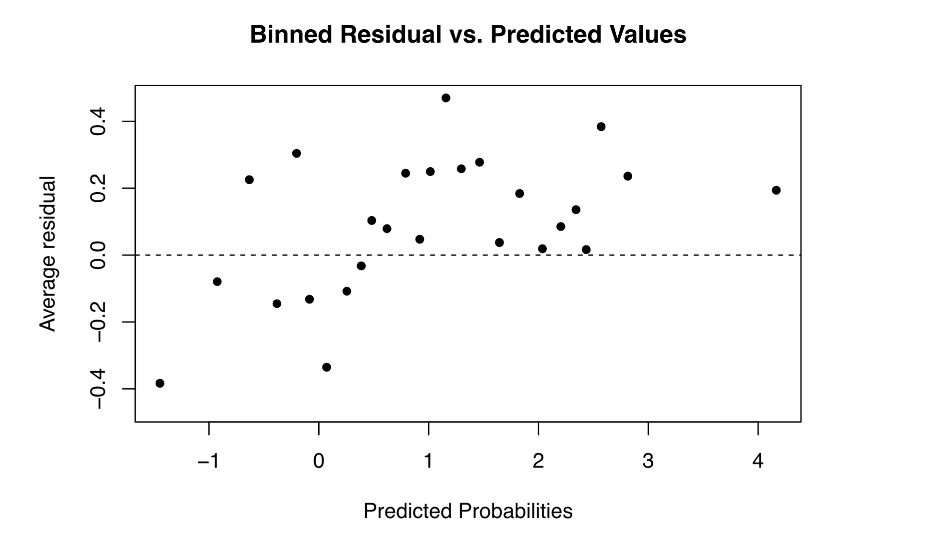
Residual Diagnostics
Notes:
This is the binned residual plot. As you can see, the average residuals are kind of symmetric about 0.

Slide 33
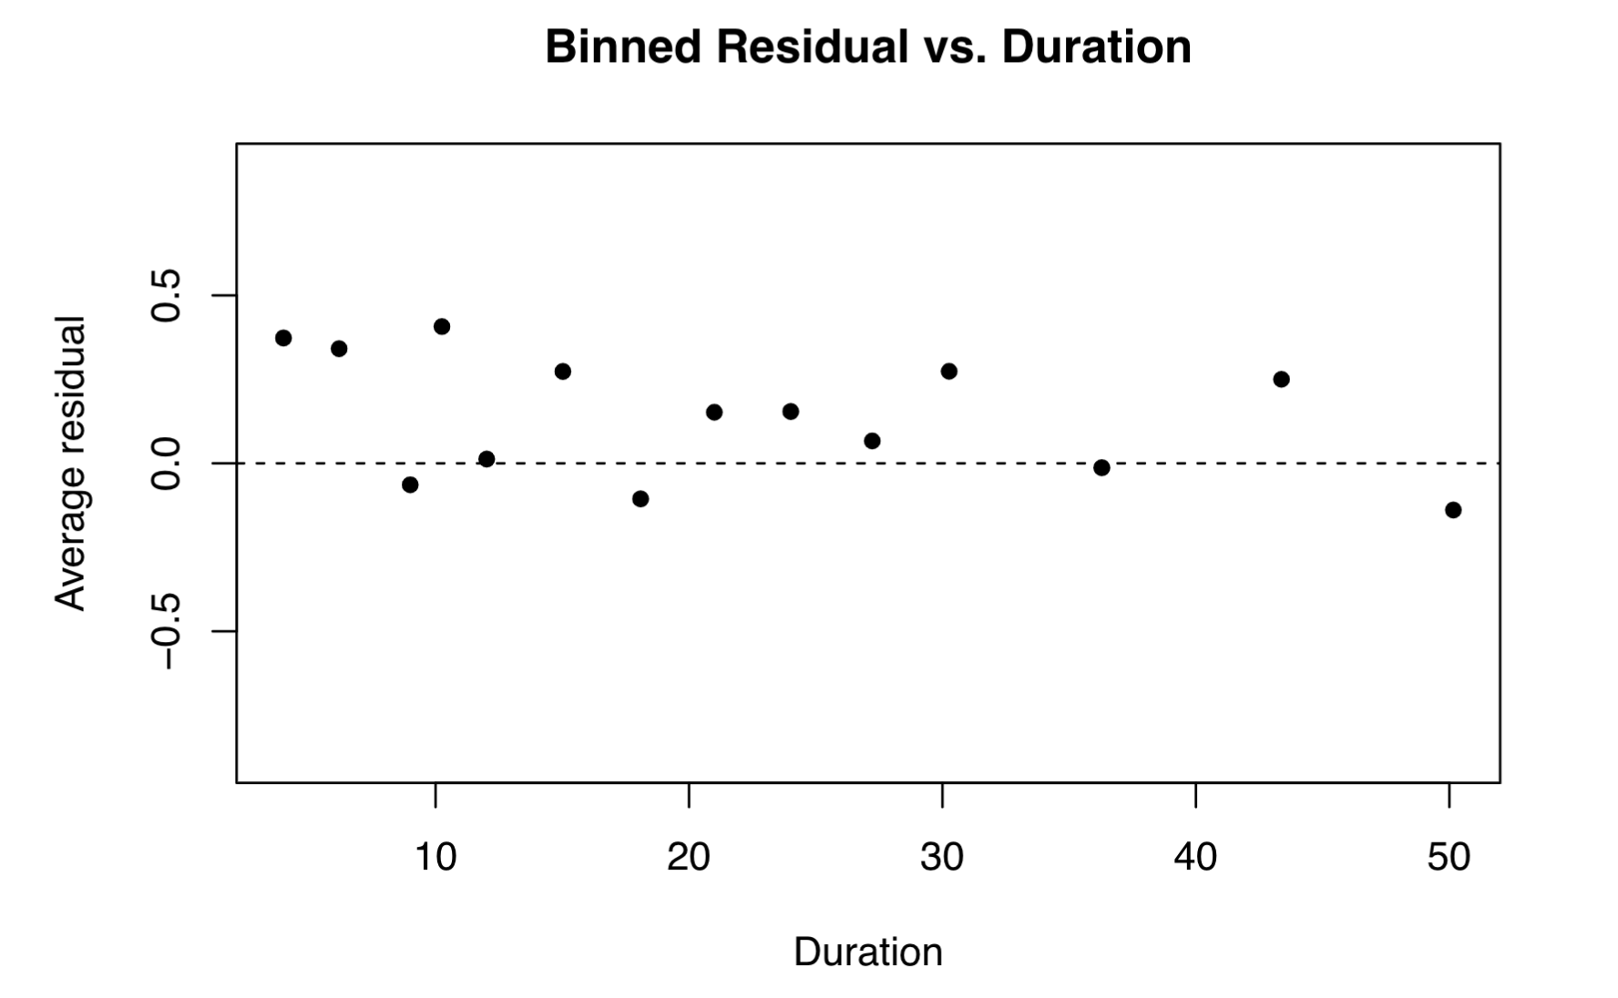
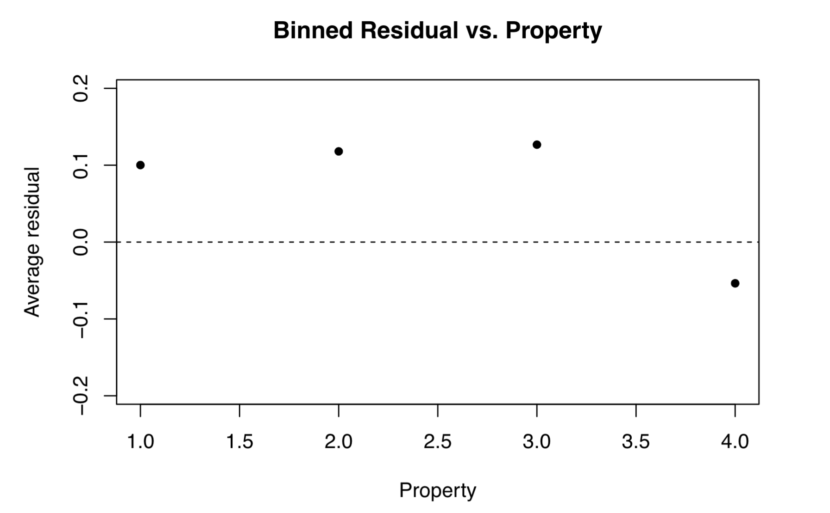
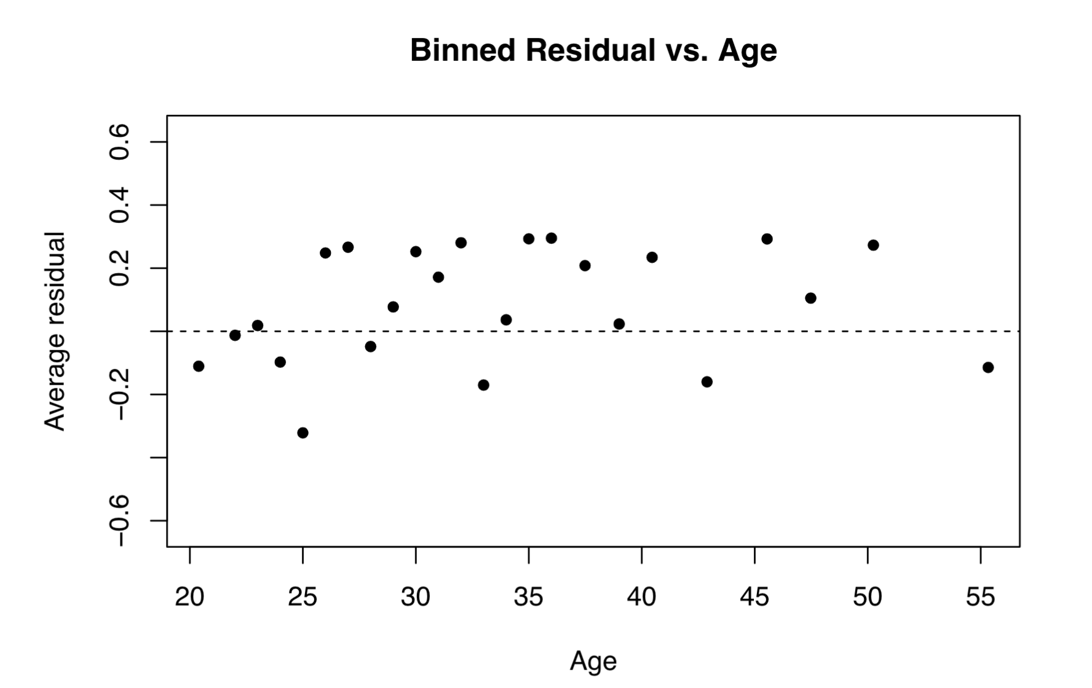
Residual Diagnostics
Notes:
Here are the plots for quantitative variables. The mean of the average residuals are also near to 0.

Slide 34
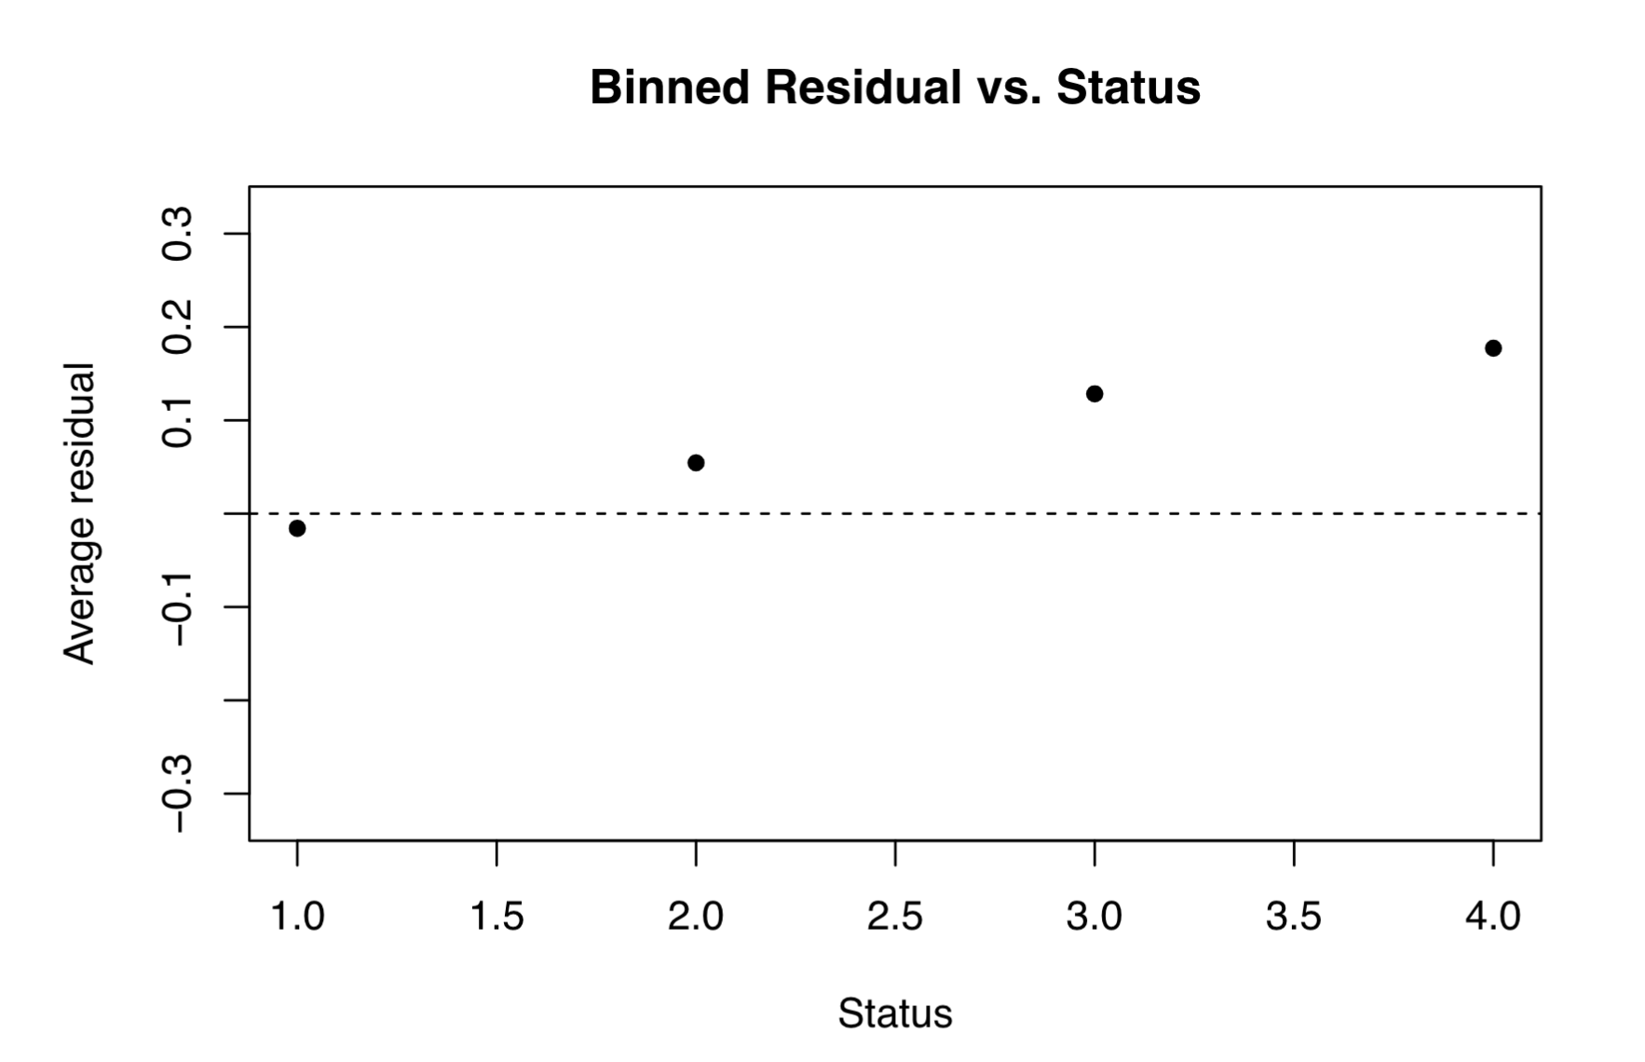
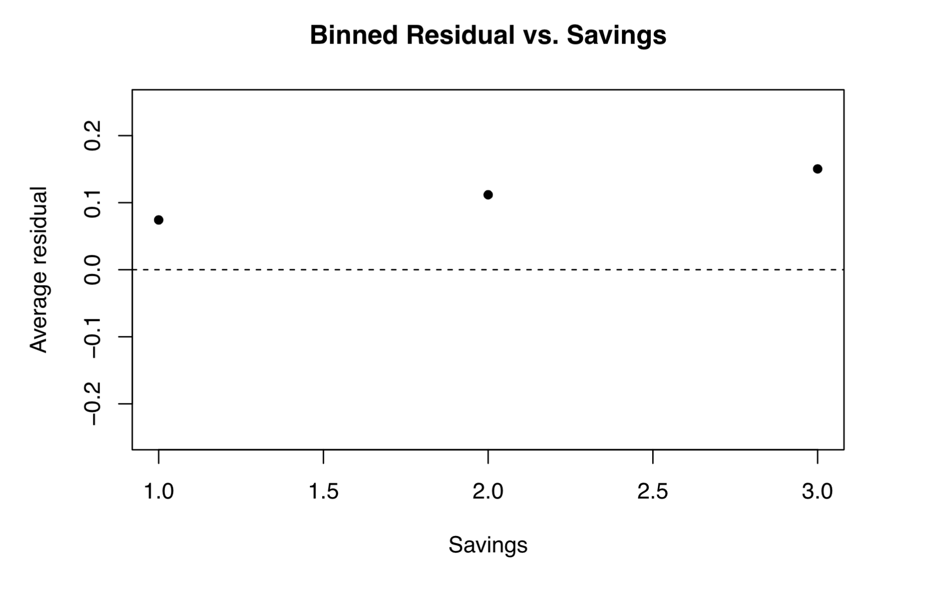
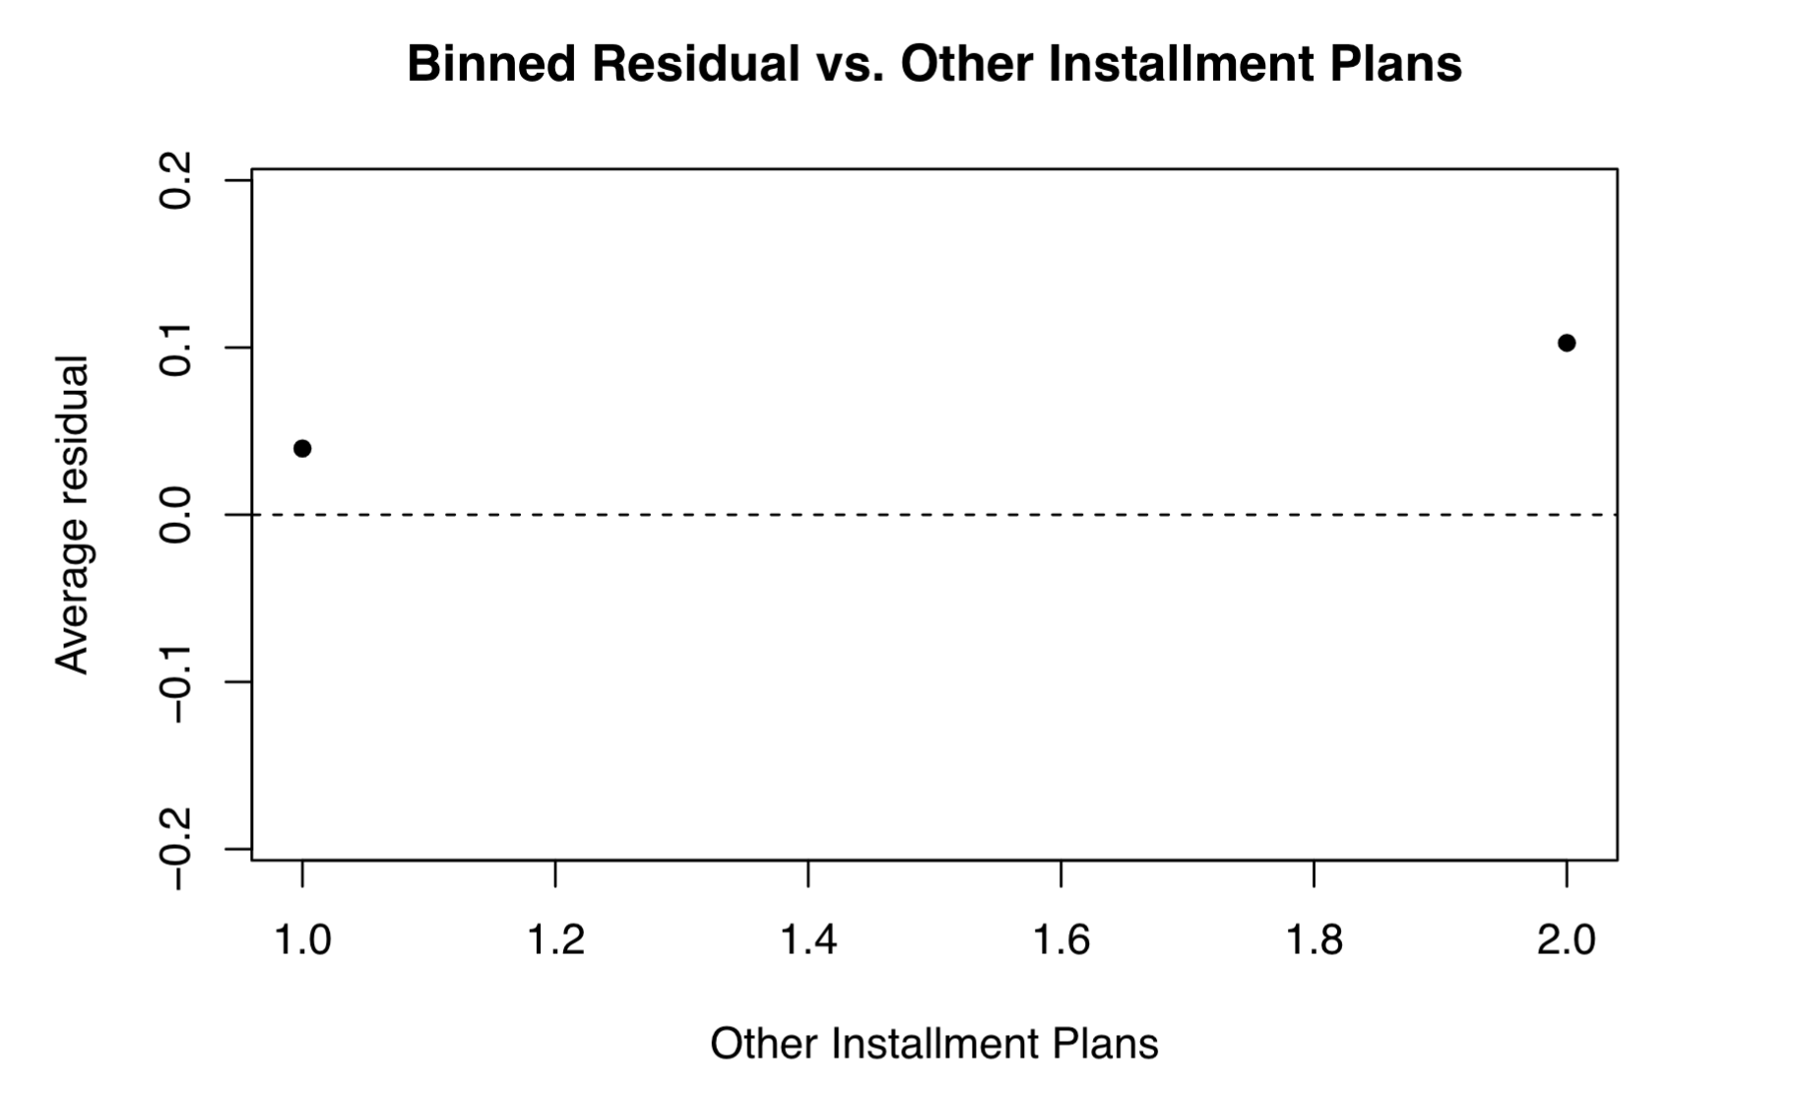
Residual Diagnostics
Notes:
This is for qualitative variables. The mean residuals is also near to 0 as well. Now, in conclusion, our model passes the validation process and diagnostics.

Slide 35
04
Conclusion
Impact, Limitations & Future Improvements
Notes:
So what can we learn from this research?

Slide 36
Conclusion
Impact
Most Significant Predictors: status, duration, property, age
High sensitivity and specificity
AUC=0.772
Limitation
Future Improvements
Only for people aged under 60
More data for seniors
Data from different regions/countries
Notes:
In summary, we obtain several significant predictors, high sensitivity, specificity and AUC. However, our model can only be used for people aged under 60. So in the future, we may consider adding more data for seniors and maybe from different regions/countries.

Slide 37

Thank you!
Lu Zheng sophieluu.zheng@mail.utoronto.ca
Yuxin Yao yuxin.yao@mail.utoronto.ca
Zhiquan Cui zhiquan.cui@mail.utoronto.ca
Notes:
That’s all for our presentation! Thank you!

